Slide 1
Zodiacal light and Fabry-Pérot interferometers
Alex A. Takeda Aug. 18, 2010
Mentor Dr. Alexander Kutyrev

Slide 2
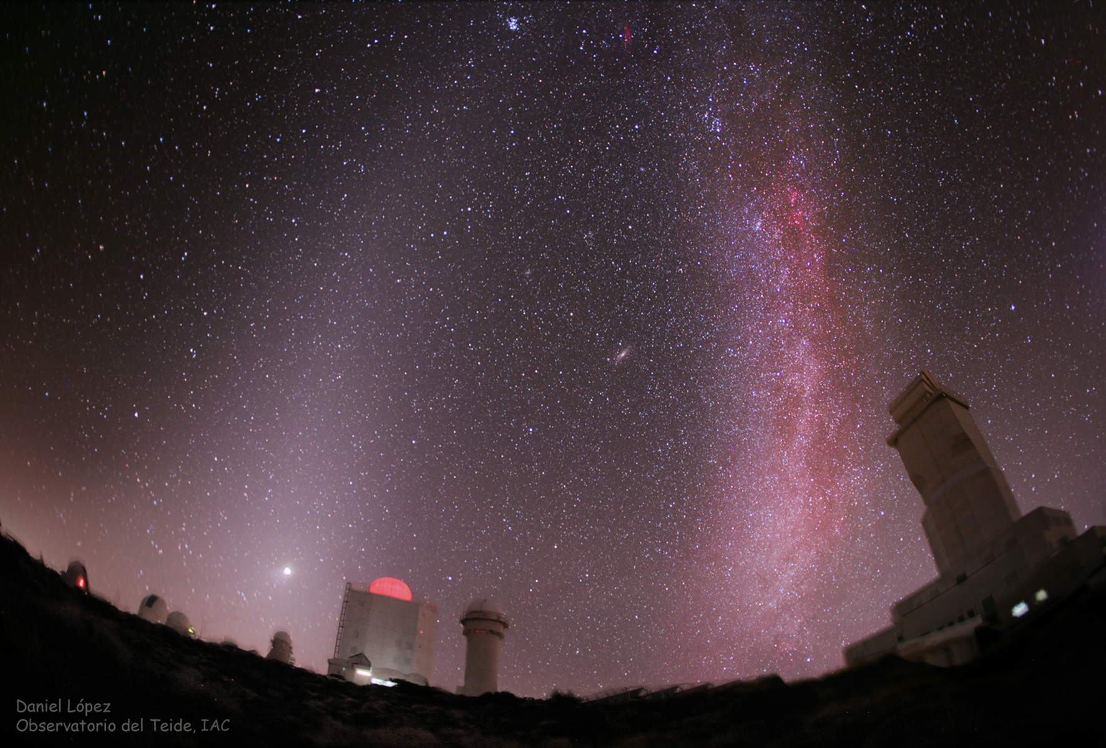
Zodiacal light
Sunlight scattered by dust particles in the solar system
Affects measurements of near-infrared extragalactic background light (EBL)
Precise measurement of ZL in the near-IR will allow validation of EBL models

Slide 3
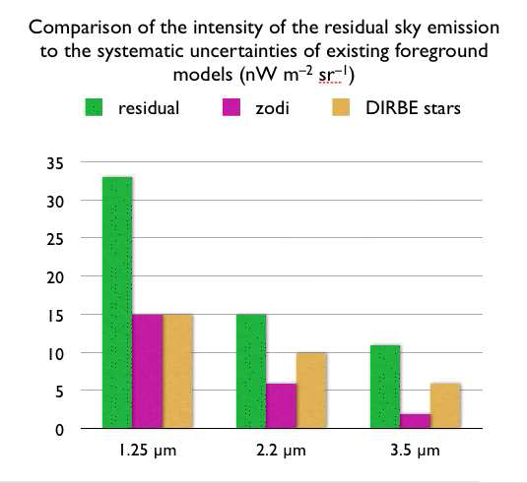
Zodiacal light
Zodiacal light carries solar spectral signature
Strength of solar absorption line vs. adjacent continuum determines the contribution from zodiacal light
Already done for UV and visual wavelengths
Line to be used is Si I absorption line at 1.2274 µm

Slide 4
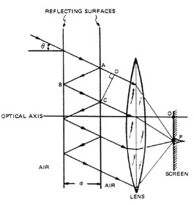
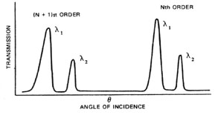
Fabry-Pérot interferometer
Étalon transparent plate with two reflecting surfaces
Transmission of different wavelengths occurs at different angles
High spectral resolution

Slide 5
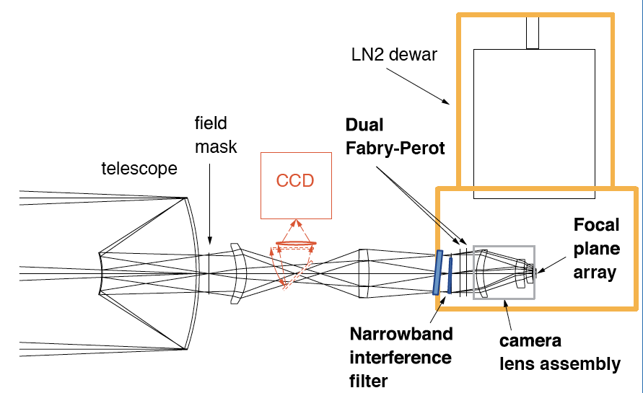
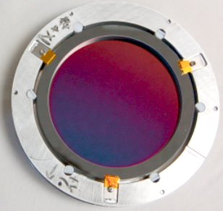
Instrument
Core of instrument is composed of two étalons and a narrow band filter
Étalons are tuned using temperature instead of actual displacement
Filter suppresses out-of-band transmission

Slide 6
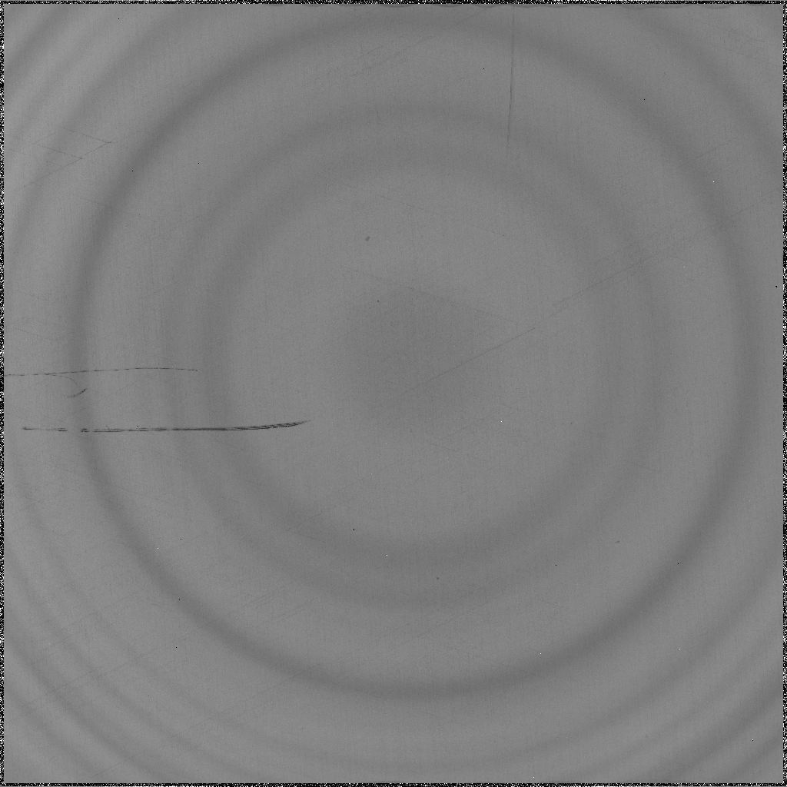
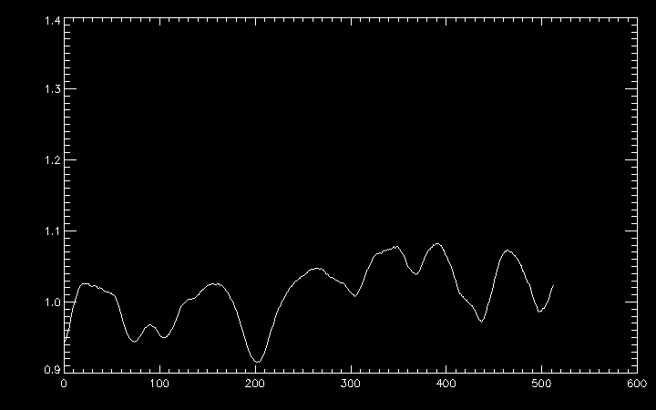
Instrument output
Dependence on angle generates ring pattern
Averaging the intensity over pixels that are equidistant from the center gives spectrum
Profile shows consecutive orders of the same spectral range

Slide 7
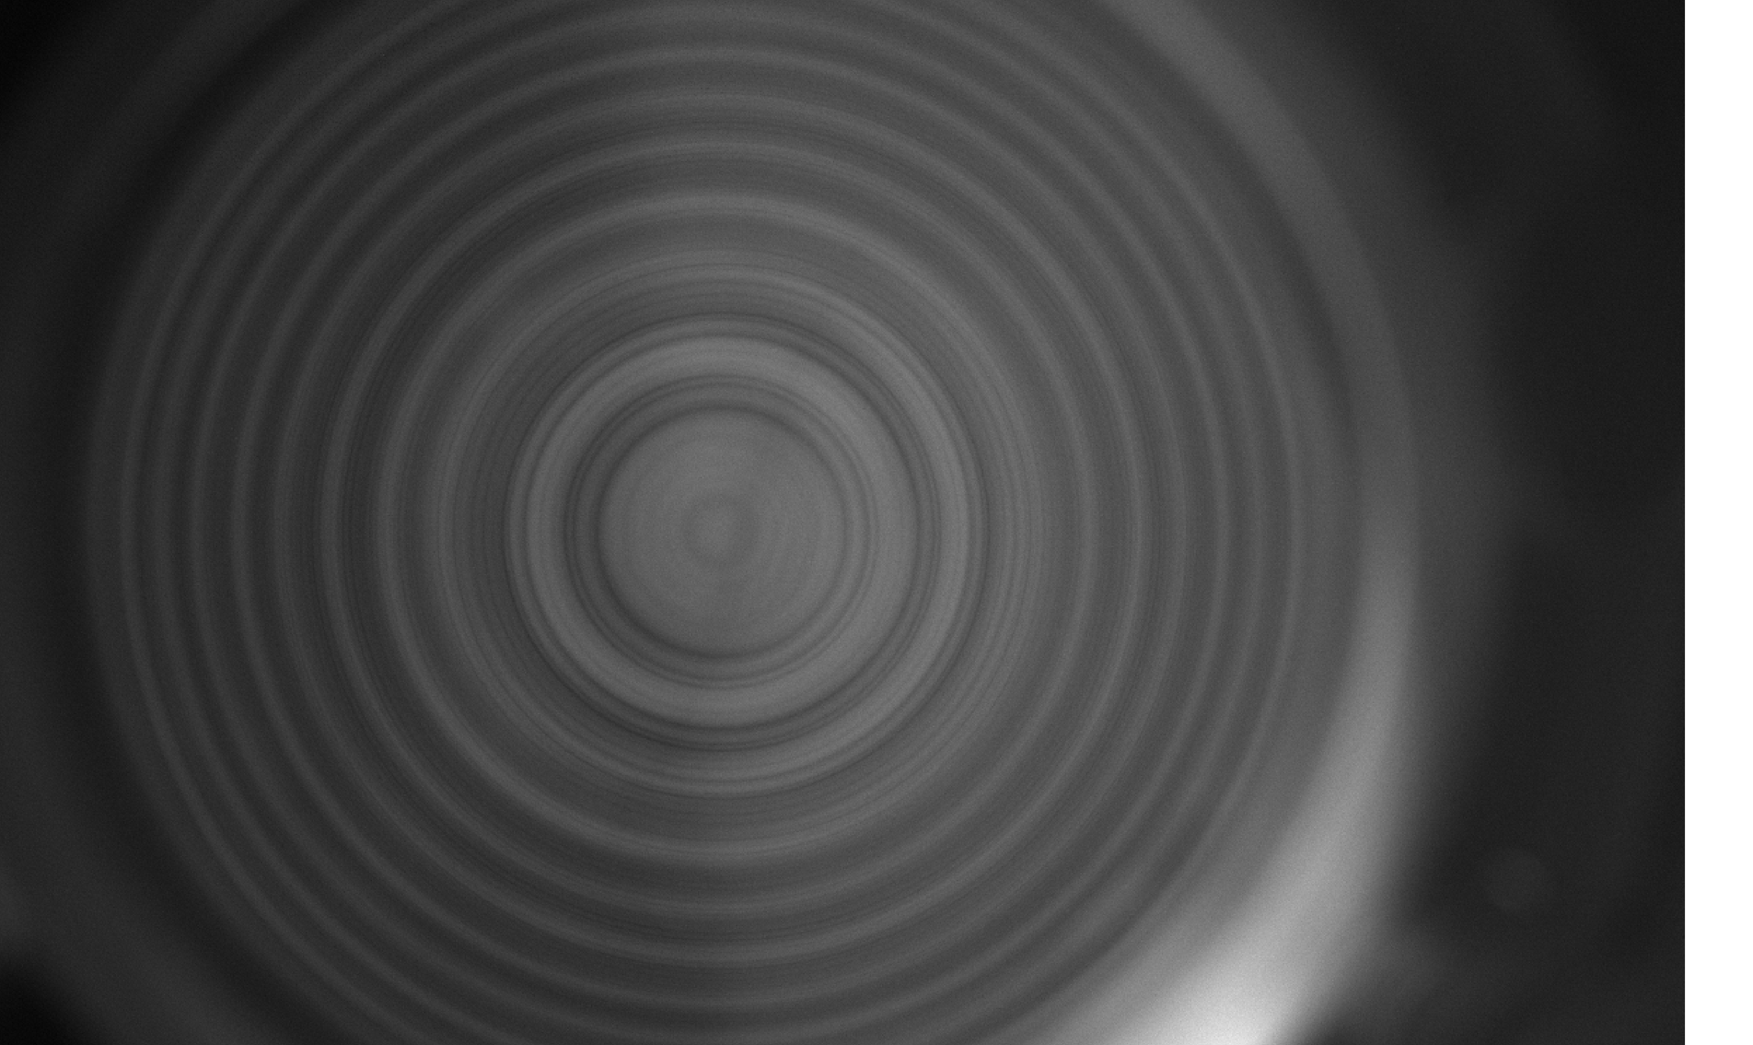
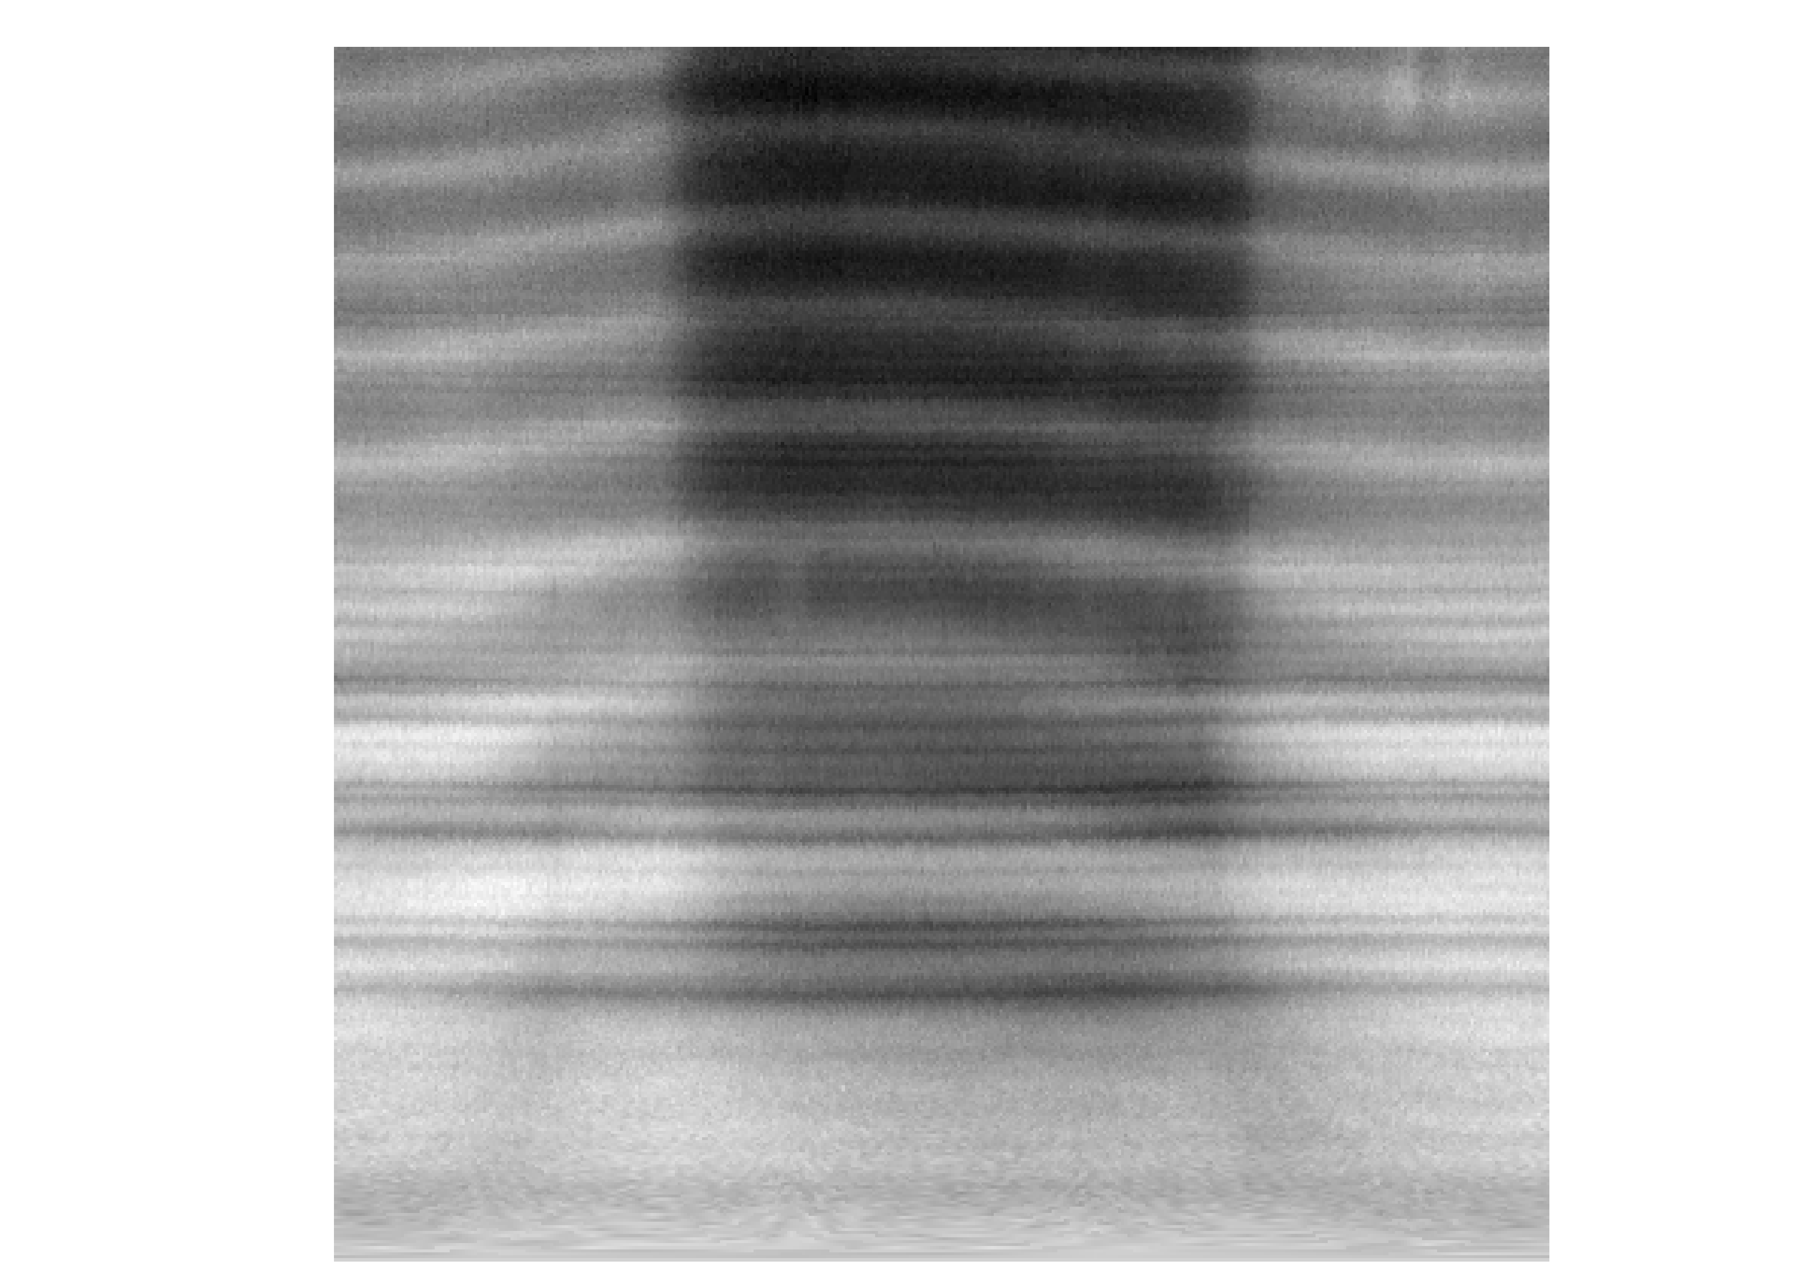
Alignment
Lines of higher order, i.e. far from the center, were often broadened, which could have been caused by misalignment
Analyses were made on another étalon, operating on the visible
When alignment was done correctly, rings were shown not to be significantly distorted

Slide 8
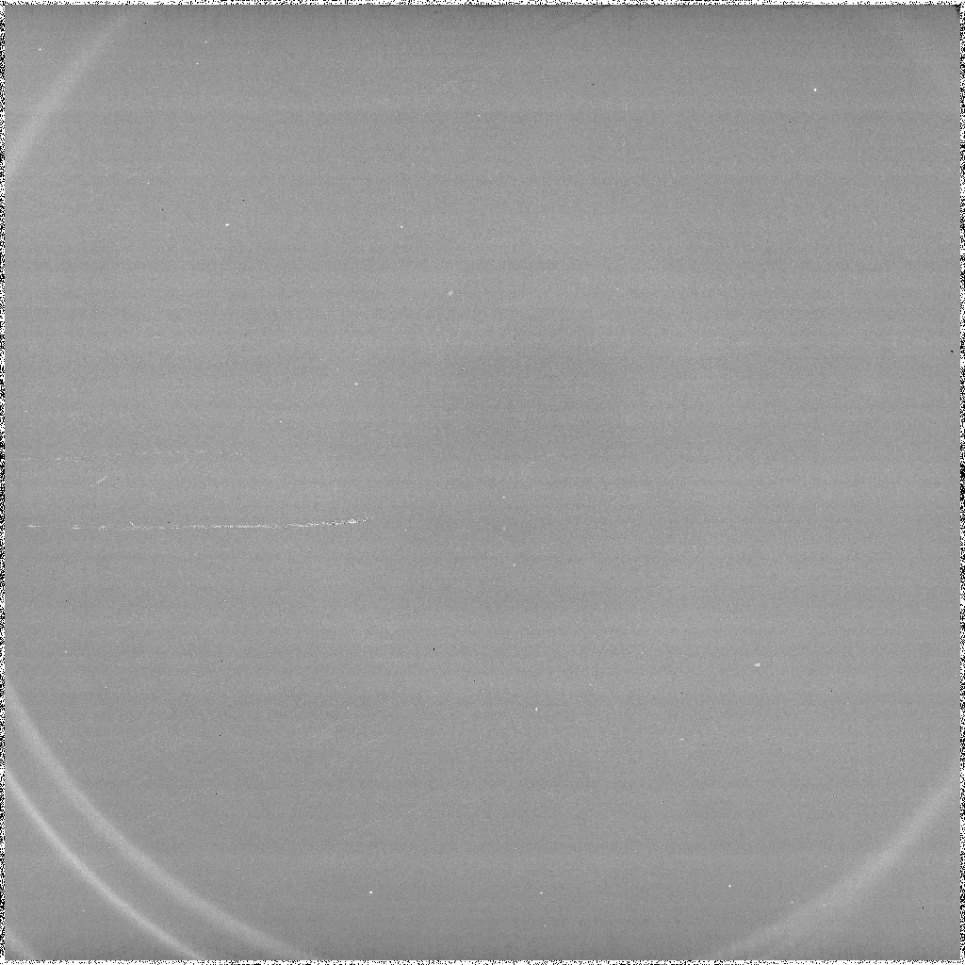
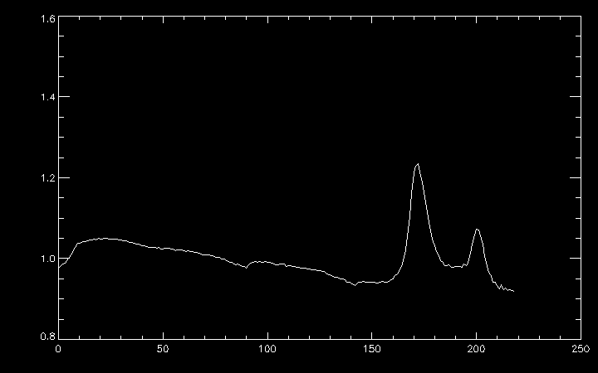
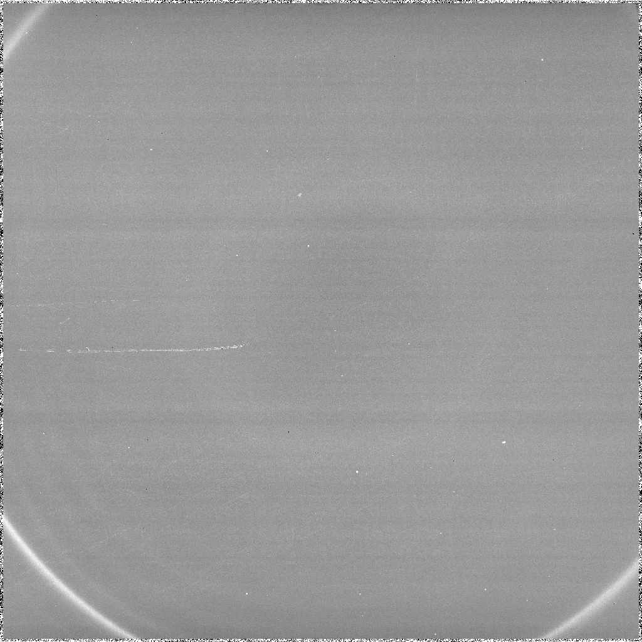
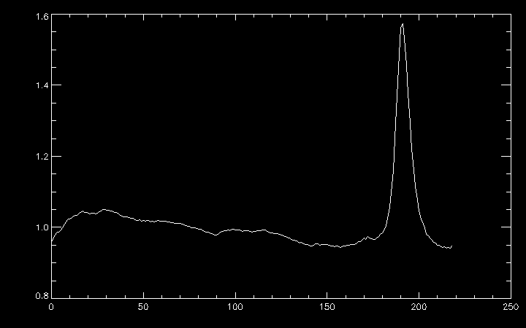

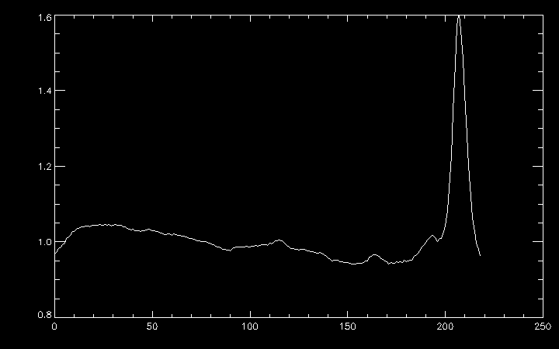
Roomlight spectra (one étalon)
Sharp emission lines from room light provide a clean and sharp spectrum
As temperature increases, rings expand and spectrum shifts
However, the intensity of the lines also varies
T = 115 K
T = 120 K
T = 125 K

Slide 9
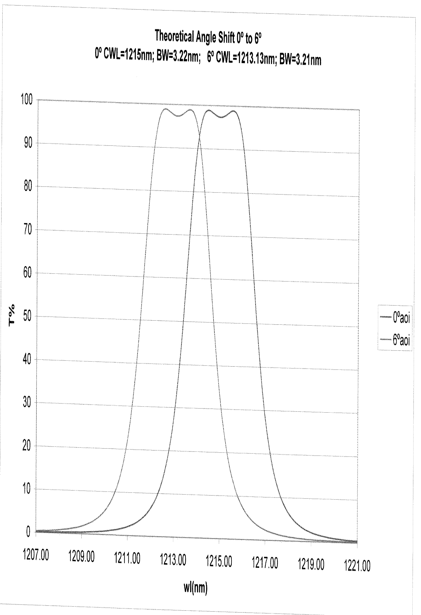
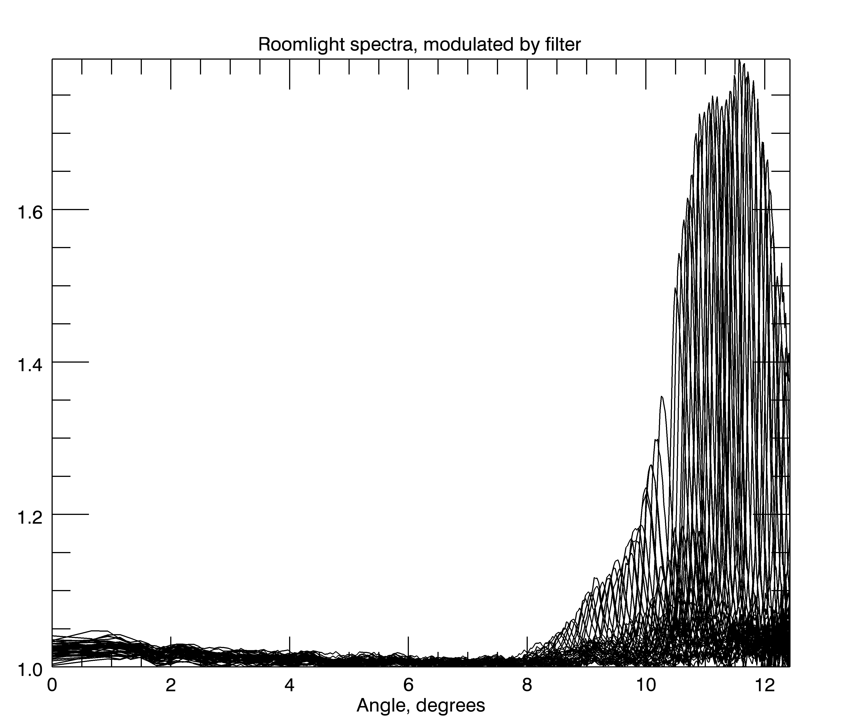
Influence of filter
Filter’s transmission depends not only on the wavelength, but also on angle
Filter transmission profile agrees with reference

Slide 10
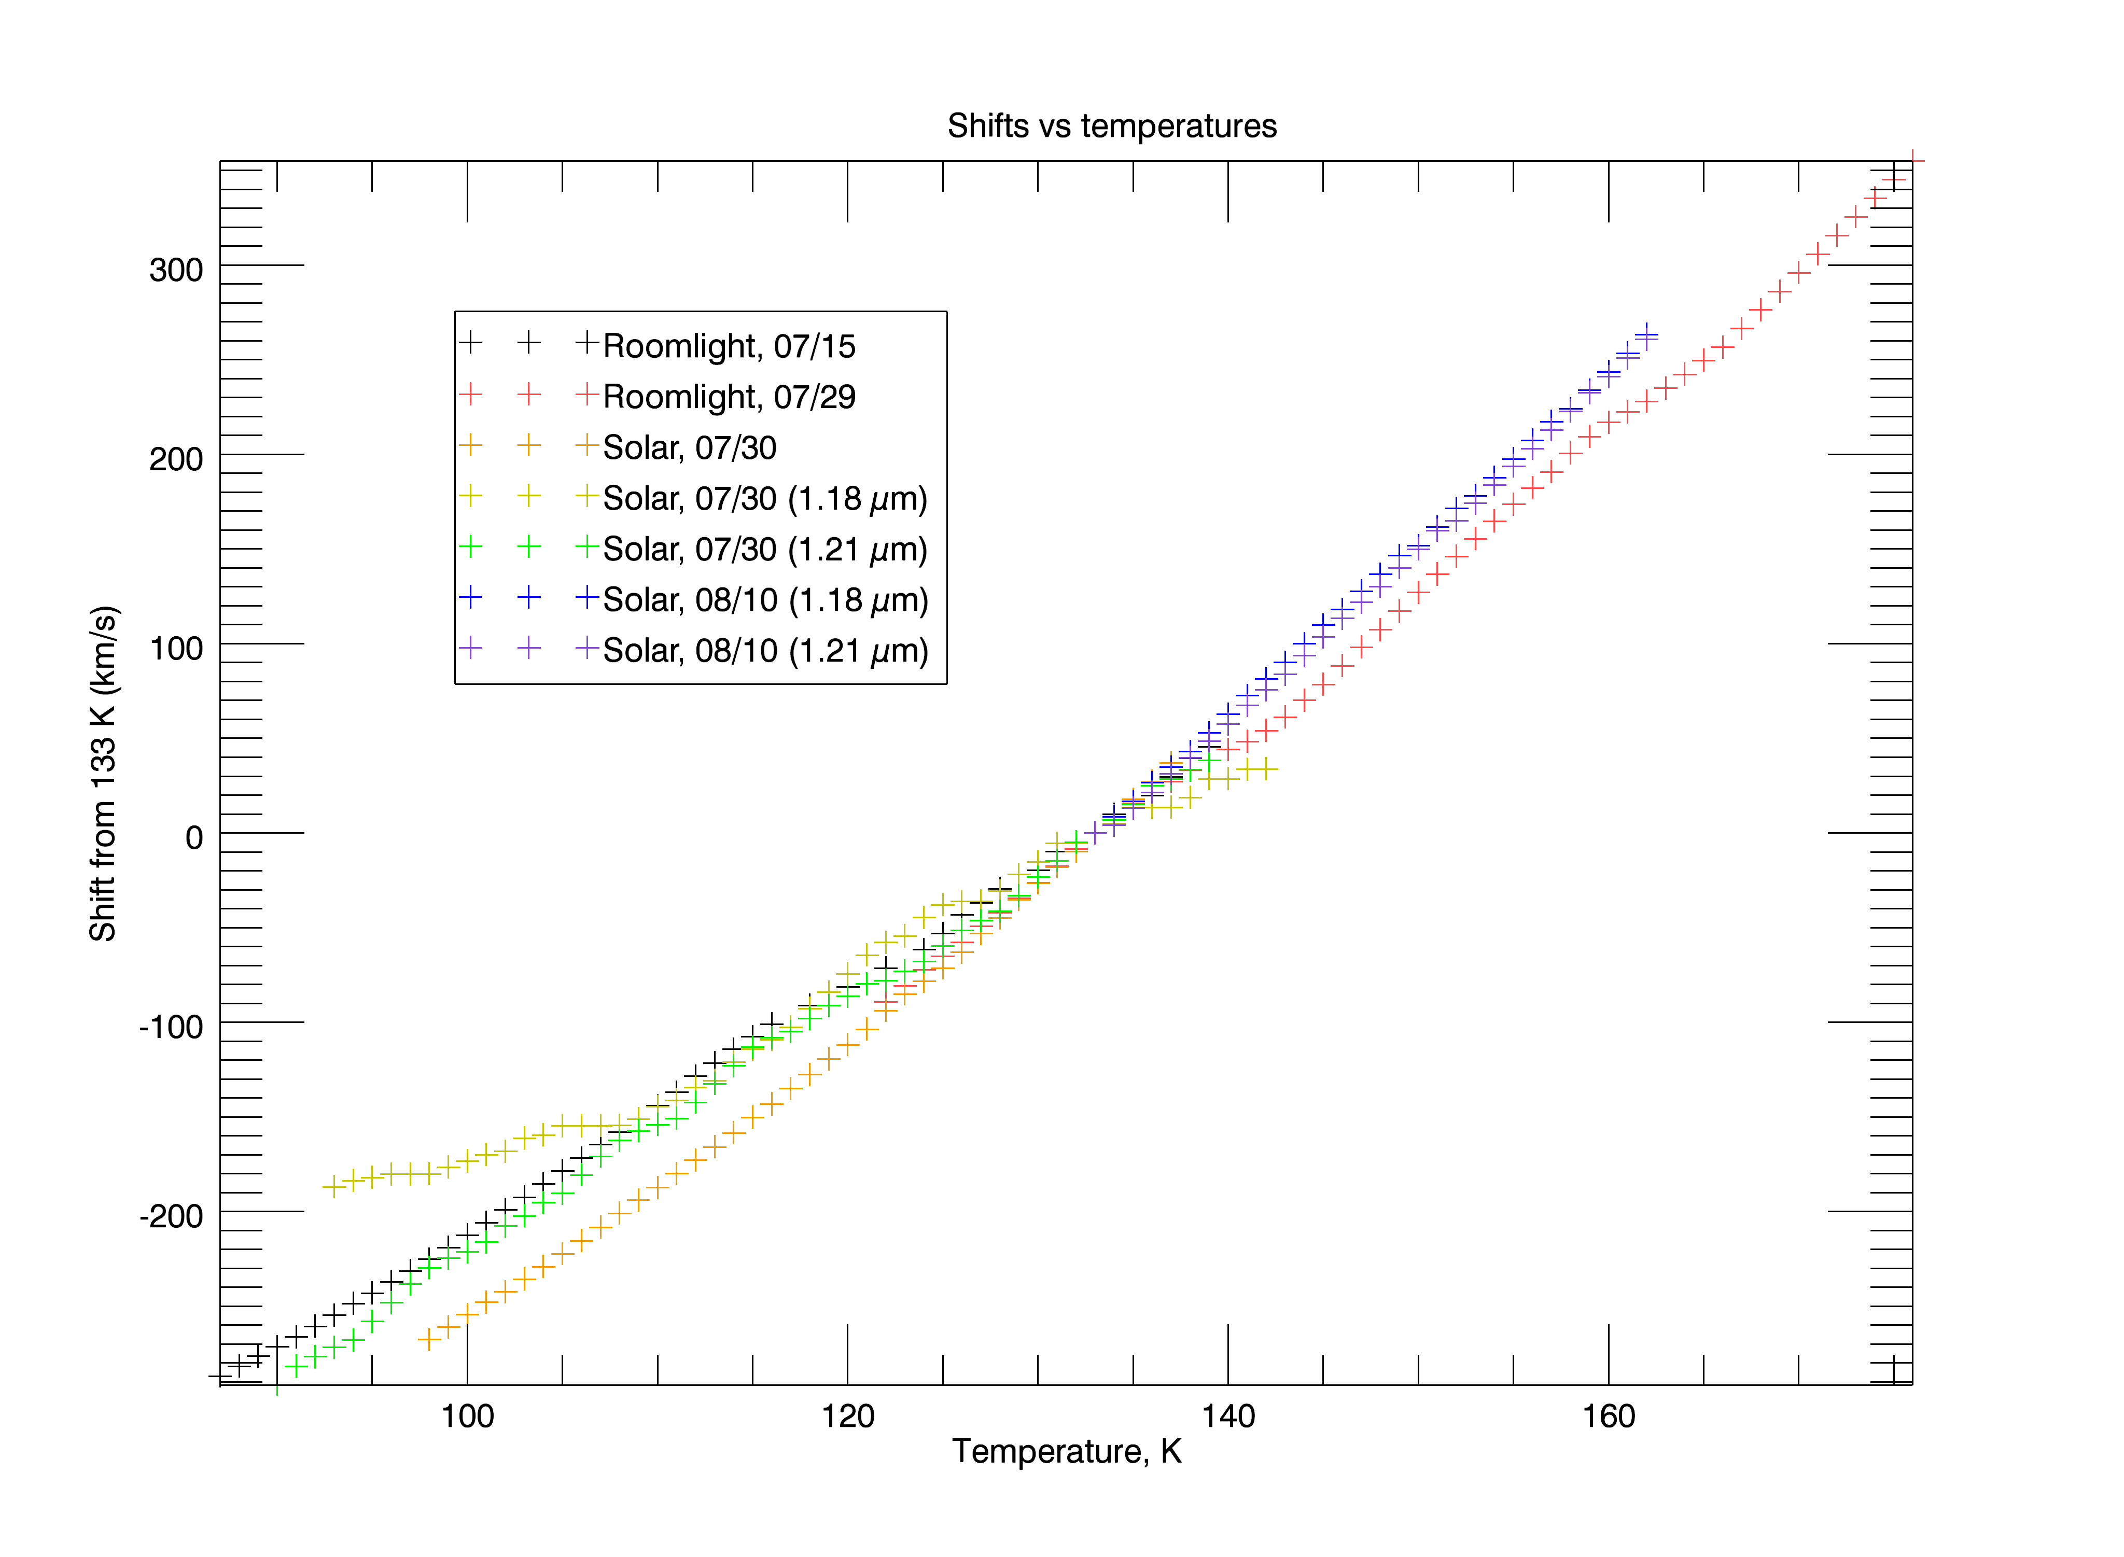
Temperature dependence
Temperature dependence of output is approximately linear
Rate of 7.7 km/s per kelvin

Slide 11
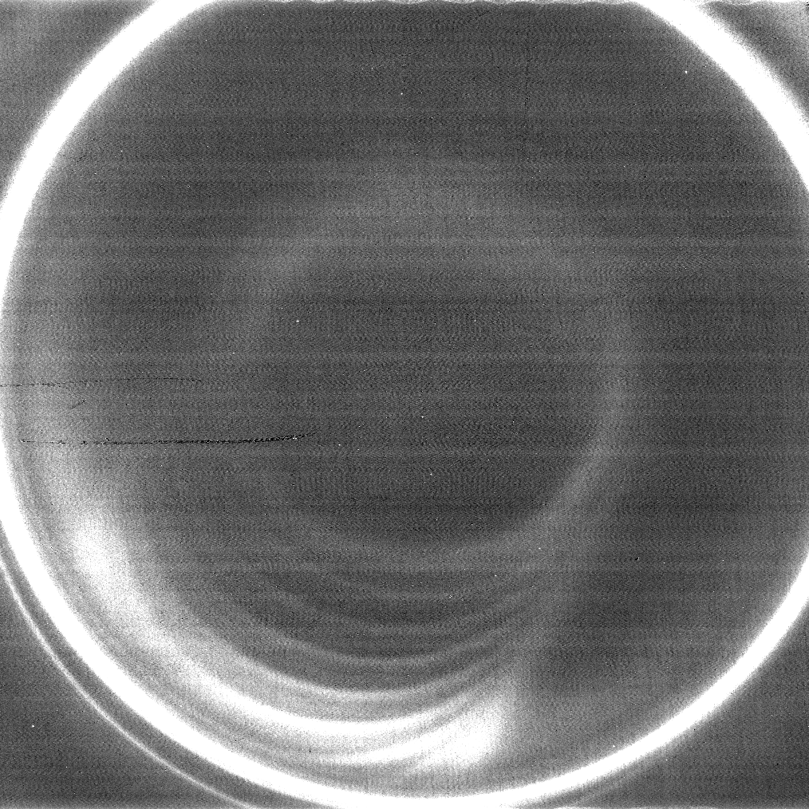
Attempt at double étalon
First introduction of second étalon was not very successful
Ghosts were probably caused by a tilted filter in relation to the étalon, generating reflections

Slide 12
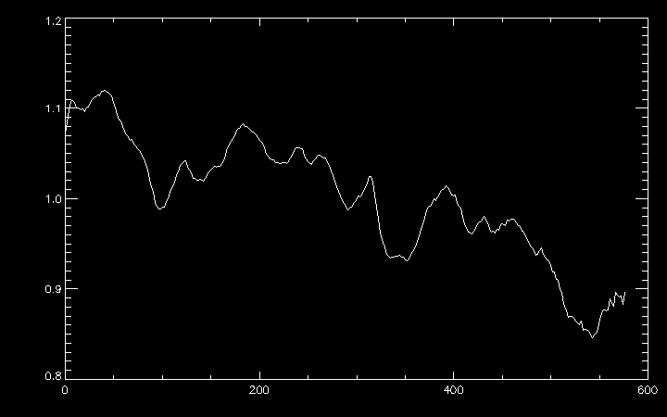
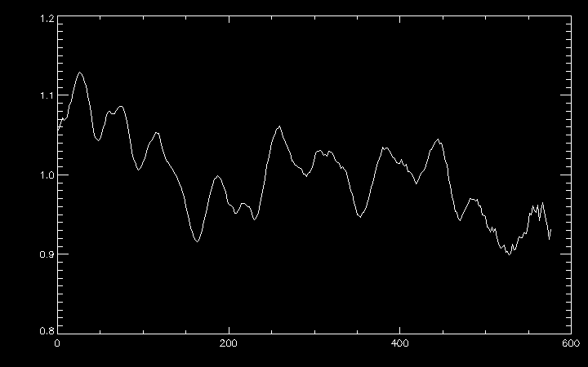
Solar spectra (single étalon)
Solar spectra, 1.18 µm filter (133 to 162 K)
With only one étalon, many different orders overlap
Hard to find correlations between the solar reference spectrum and the highly convoluted output
As filter depends on the angle, convolution is even more complex
Solar spectra, 1.21 µm filter (133 to 162 K)

Slide 13
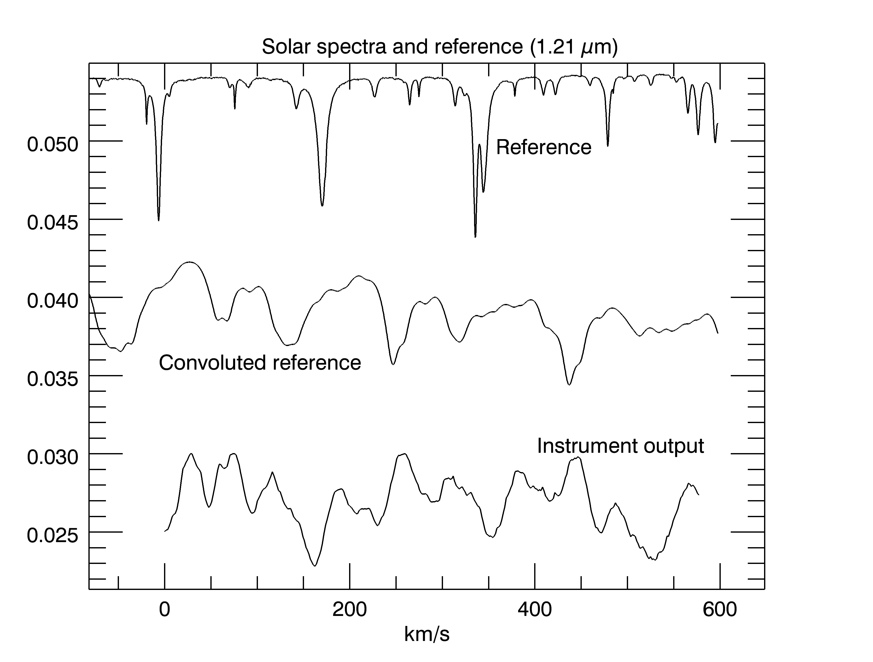
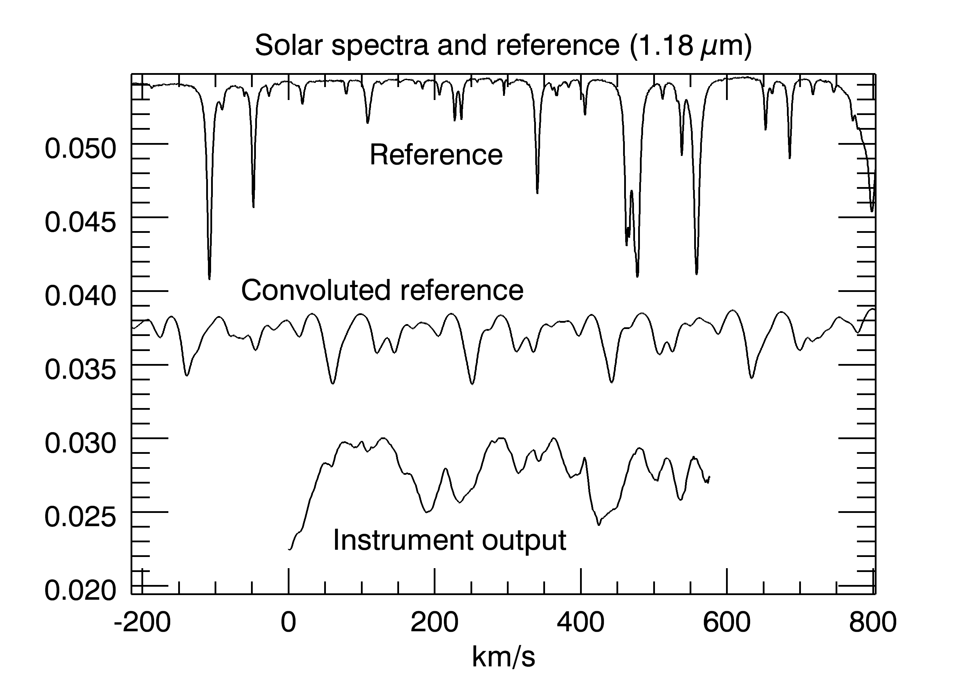
Solar spectra (single étalon)
Using mathematical models of the étalon, it is possible to simulate its effects on reference spectra

Slide 14
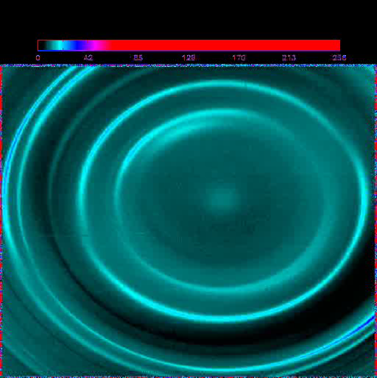
Second attempt at double étalon
Using two étalons solves the problem of overlapping
Range of wavelengths transmitted through both étalons is very narrow
Unfortunately, there seems to be a problem with one of the étalons
Data obtained by Dr. Kutyrev

Slide 15
What’s next?
During next week, use each of the étalons at a time and fully characterize their parameters
IDL routines written hopefully will be helpful when the instrument is finished and both étalons are operational

